Slide 1
Context-Aware Testing for Financial Ecosystems
HallucinAItors
Behave Yourself - Your BDD Buddy

Slide 2
Contents
Problem Statement
Proposed Solution
Architecture
Flow of Control
Toolkits
Future Scope
Summary

Slide 3
Problem Statement
To develop a context-aware testing system leveraging GenAI to dynamically validate different financial ecosystems.
A significant amount of time goes into analyzing the codebase and ecosystem of microservices for creating BDD test cases. This takes away from developer productivity.
The task of testing is often tedious as well, more often than usual, left for last minute. This sometimes impacts release activities, which have a mandate for these test cases.

Slide 4
Proposed Solution
We propose our own agentic architecture that handles all the tasks that a developer performs with regards to BDD testing.
This includes gaining context from the Github repository, whether from the pull requests or the codebase itself, as well as the database and JIRA setup.
When the test cases are successfully generated, a JIRA story is posted to ensure human validation of test cases is completed.

Slide 5
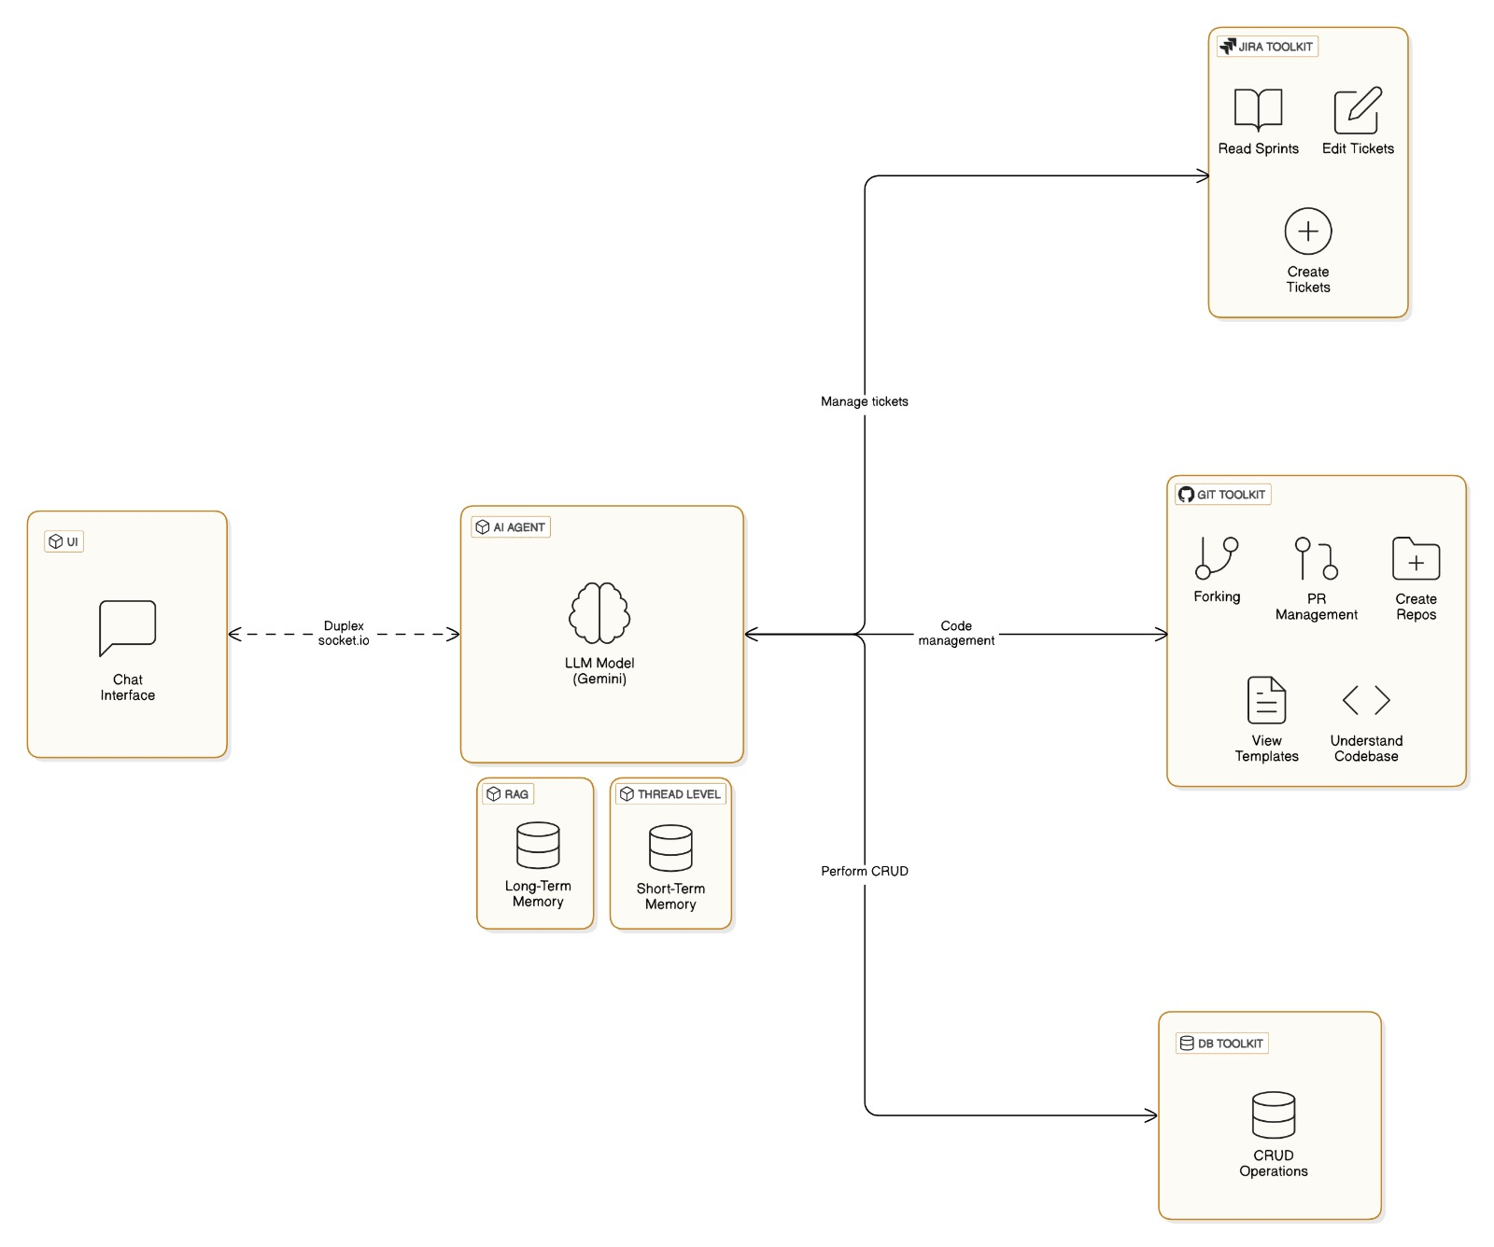
Architecture

Slide 6
Toolkits
We have implemented 3 toolkits that the agent can utilize - based on JIRA, GitHub and MongoDB (database).
The JIRA toolkit makes use of the JIRA API and JQL (Jira Query Language) to provide additional context and help in automated ticket generation.
The GitHub toolkit is the main driver of our system. It facilitates codebase analysis as well as transactions such as fetching repository structures, tracking file changes, managing pull requests, and comparing code snapshots to streamline development and collaboration.
The MongoDB Toolkit manages and queries memory data in MongoDB. It supports recording, recalling, and updating memories, fetching payment records, and generating structured tools for seamless integration with other systems.

Slide 7
Flow of Control
Some of the scenarios that our agent can handle are as follows:-
BDD Repository Analysis: Evaluates existing repository data by recalling memory, reviewing Jira tickets, comparing pull request differences, and examining the codebase to extract key insights.
BDD Repository Creation: Establishes a new repository based on predefined templates, integrates memory for context, and manages initial edits before generating Jira tickets and pull requests.
BDD Repository Updation: Updates the repository by incorporating user inputs, verifying code changes through persistent memory, modifying repository content, and automating Jira ticket creation.

Slide 8
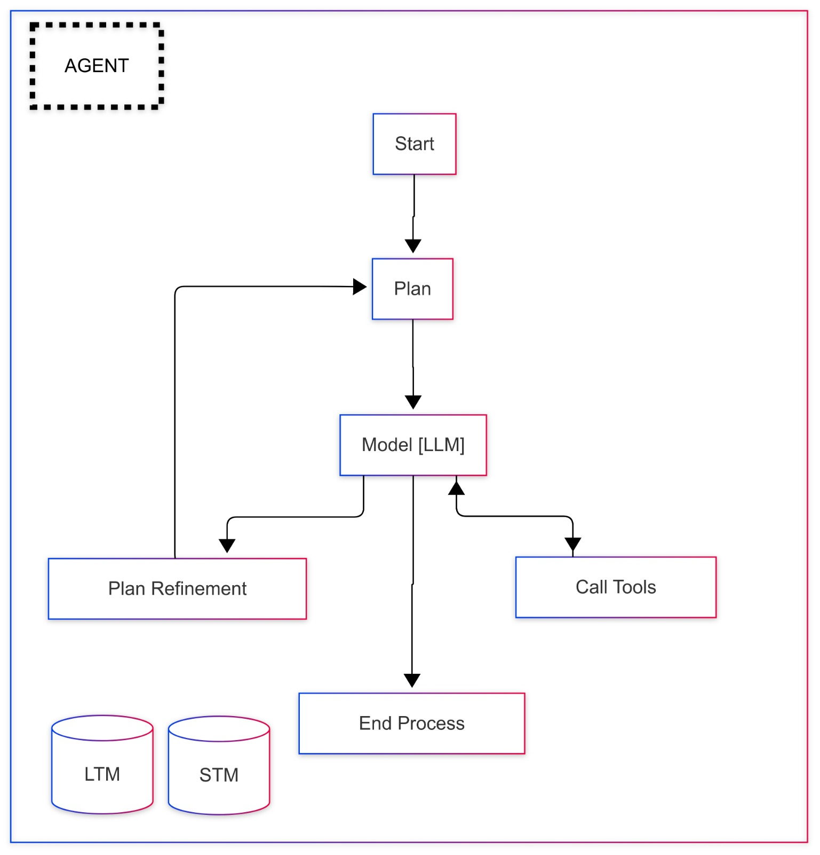
Agent Breakdown
Agent Workflow

Slide 9
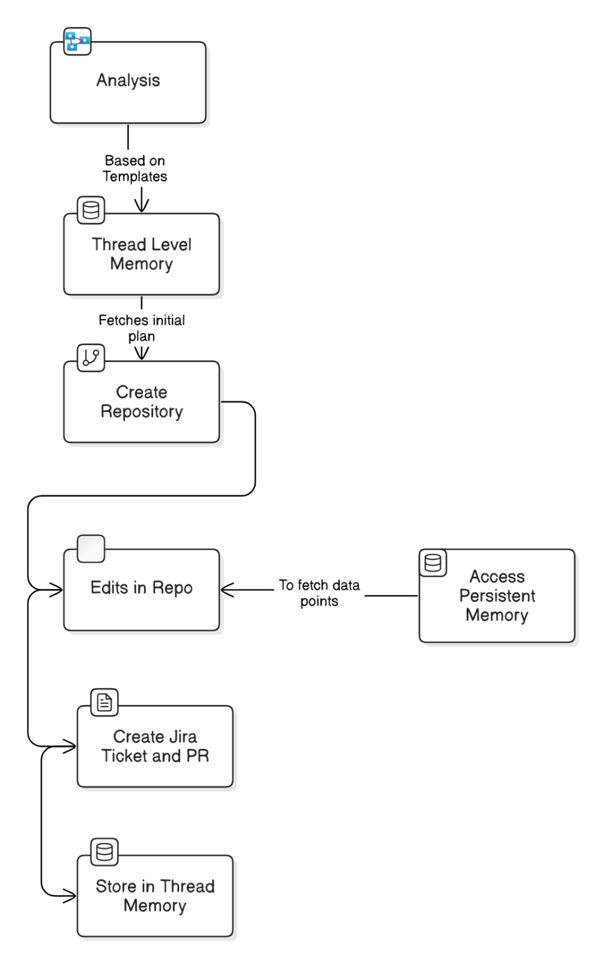
Flow of Control
Create BDD repository

Slide 10
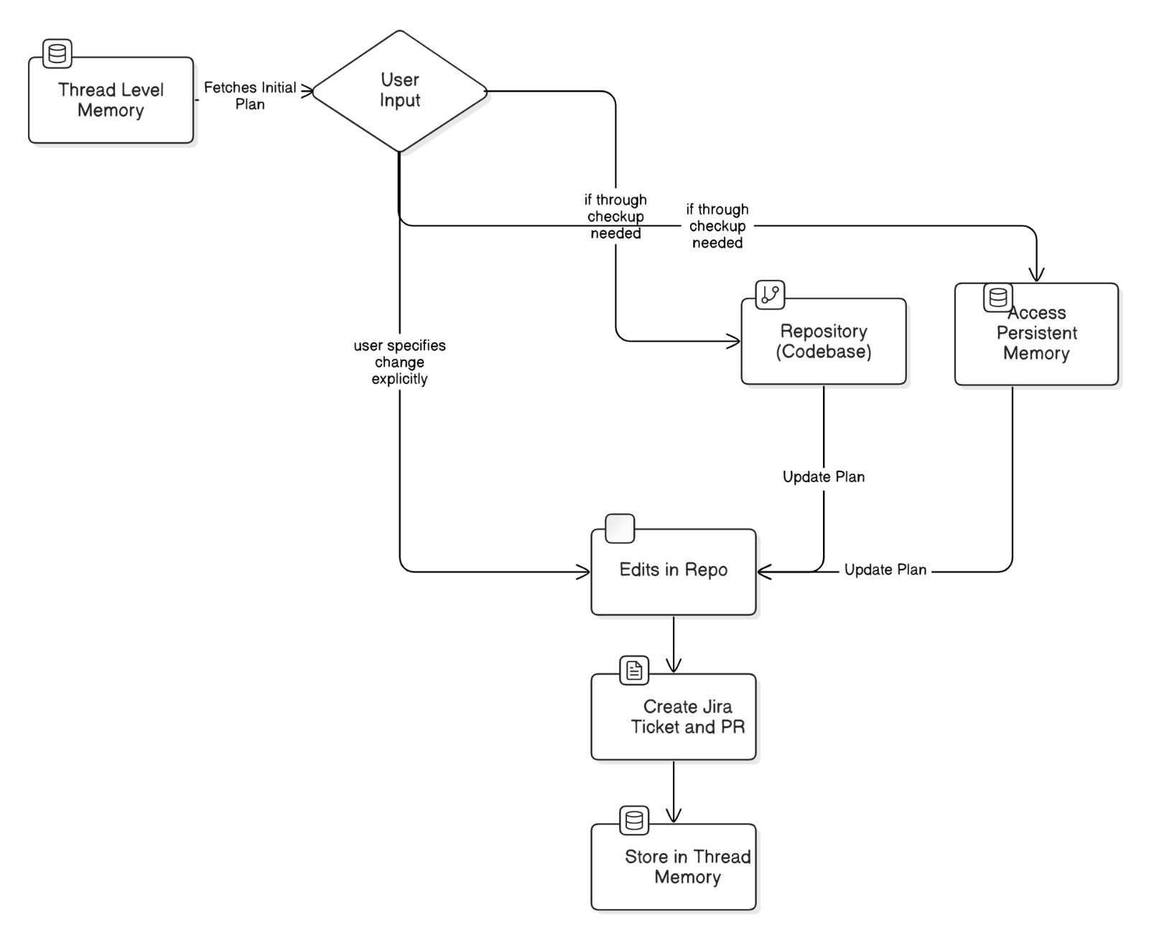
Flow of Control
Update BDD repository

Slide 11
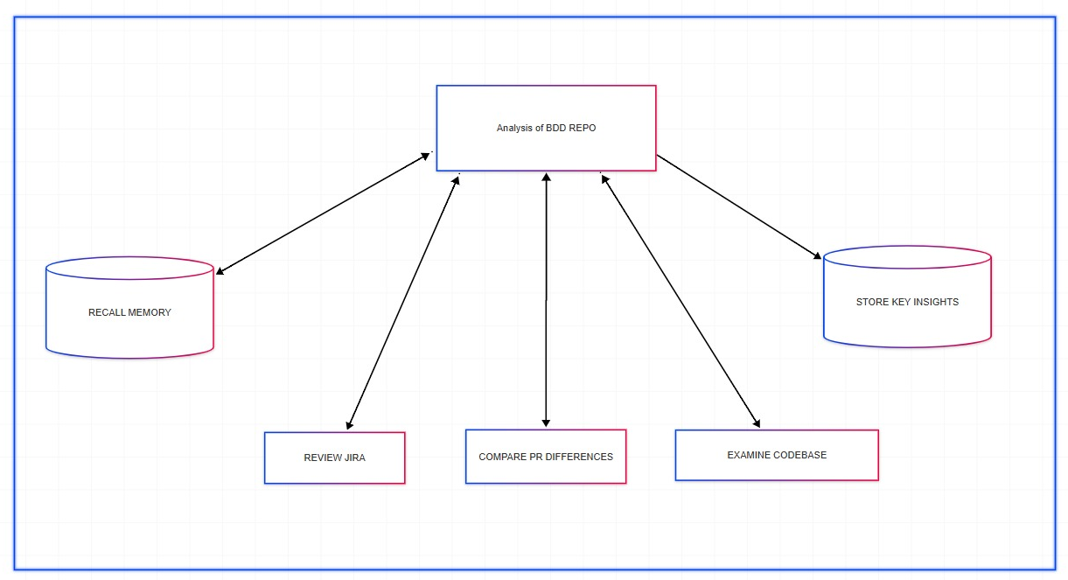
Types of Context
Analysis of BDD repository
Notes:
Analysis of bdd repo

Slide 12
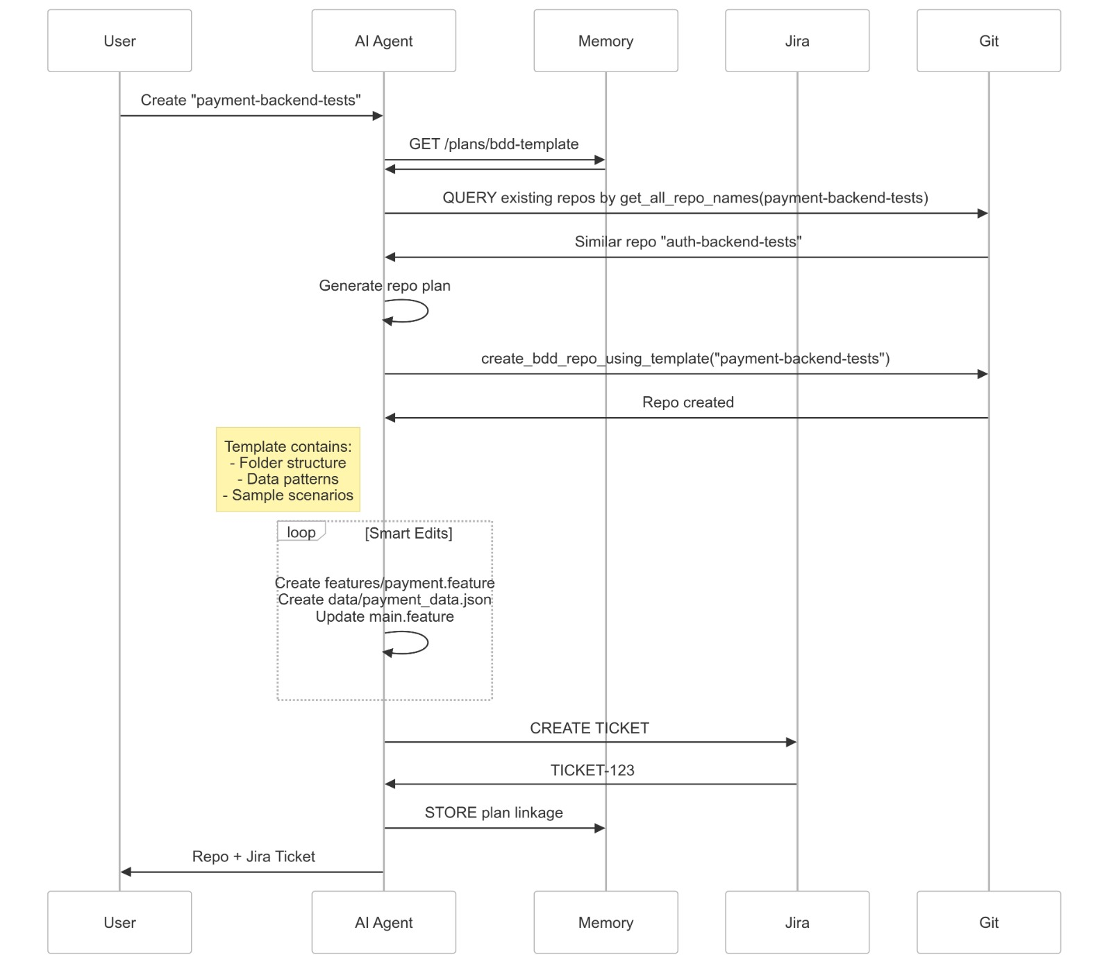
Example Scenario

Slide 13
Future Scope
Smart Stubs Creation : Utilize mock data instead of actual DB or microservices with AI-powered stubbing for dynamic responses. This helps us avoid security issues that accompany Direct DB Access
CI/CD Integration : Automate testing with Jenkins/GitHub Actions so that we can provide end to end solution that tests and verifies the BDD suite
Playground : Build an interactive testing space with real-time feedback, dashboards for test visualization. User can interact with these visualizations to provide better understanding to the Agent

